Slide 1
DIGITAL LOGIC DESIGN
EE(109)
LECTURE-10
DATE: 12TH FEB, 2018

Slide 2
Chapter No:4
Boolean Algebra and logic Simplification

Slide 3
LOGIC CIRCUITS OR LOGIC GATES :
The operation of different logic gates and complex circuits can be described and analyzed using Boolean Algebra
Boolean algebra:
is a mathematical tool that allows us to describe the relationship between a logic circuit’s output and its inputs as an algebraic equation (Boolean Expression).
Other techniques used in the analysis , synthesis and documentation of logic system and circuits are :
Truth table
Schematic symbol
Timing diagrams
Language

Slide 4
Boolean algebra is a mathematical tool
Truth tables are data organizational tool
Schematic symbol s are drawing tools
Timing diagrams are graphing tools
Language is universal description tool.

Slide 5
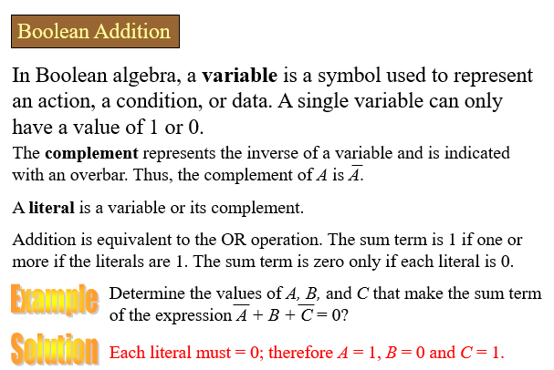

Slide 6
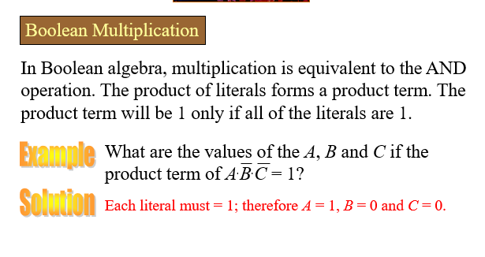

Slide 7

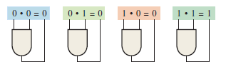
Boolean Operation and Expressions
Boolean Addition
Boolean Multiplication

Slide 8


LAWS OF BOOLEAN ALGEBRA
Commutative law :
The commutative law of addition for two variables is written as
The commutative law of multiplication for two variables is
written as

Slide 9


Associative law
The associated law of addition for three variables is written as
The associated law of multiplication for three variables is written as

Slide 10
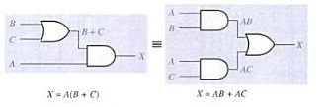
Distributive law
The distributive law is written for three variables as follows:

Slide 11
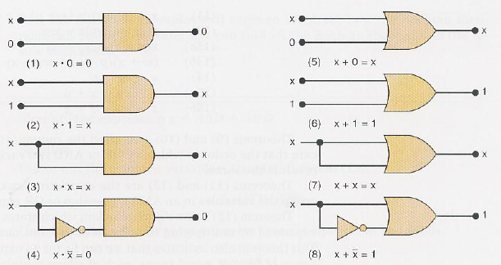
RULES OF BOOLEAN ALGEBRA
Boolean algebra can be used to help analyze a logic circuit and express its operation
Single Variable theorem :

Slide 12




MULTIVARIABLE THEOREM
It involve more than one variables.
Commutative Law:
Associative Law:
Distributive Law:
Others

Slide 13

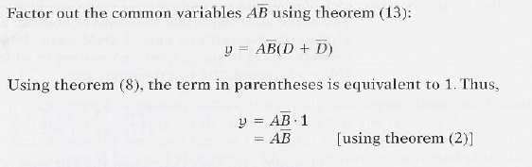
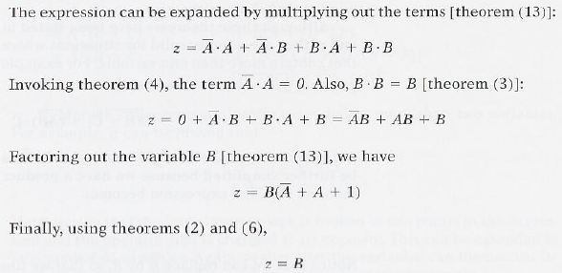
EXAMPLES:

